Slide 1
Leverage the Microsoft Graph & 3rd Party APIs
Calling Anonymous 3rd Party REST APIs
Notes:
Recorded version of this lesson available at:
https://www.youtube.com/watch?v=0zVtDn0ckBM

Slide 2

Calling Anonymous 3rd Party REST APIs
Overview Consume REST APIs in SPFx
Understanding the HTTPClient
Calling Anonymous REST APIs

Slide 3
Overview Consume REST APIs in SPFx
Common requirement in SPFx project is to display or interact with data external to the web part
Data in SharePoint lists & libraries
Data accessible via Microsoft Graph REST API
Data accessible in external 3rd Party APIs – anonymous & secured
SharePoint Framework provides APIs for all situations when you need to work with data sources external to the web part
HttpClient: for calling 3rd party REST APIs
MSGraphClient: for calling the Microsoft Graph in the same tenant as the SharePoint Online tenant
AADHttpClient: for 3rd party REST APIs secured with Azure Active Directory
Most scenarios require no extra clients / libraries are required

Slide 4
Calling 3rd Party APIs with the HTTPClient
Provided on the current SharePoint Context
this.context.httpClient
Optimized for REST APIs
Leverages the Fetch API
https://developer.mozilla.org/docs/Web/API/Fetch_API
Fully configurable HTTP headers & payload
whatwg-fetch: polyfill package for browsers that don’t implement “fetch”
Use this to:
Call anonymous REST APIs
Call secured REST APIs
You provide all logic to obtain and pass authentication details required by service
Base HTTP API in SPFx used by other clients

Slide 5
Calling Anonymous REST APIs
import { HttpClient, HttpClientResponse }
from '@microsoft/sp-http’;
return this.context.httpClient.get(
`http://[rest-endpoint]`,
HttpClient.configurations.v1
)
.then((response: HttpClientResponse) => {
return response.json();
})
.then(jsonResponse => {
return jsonResponse;
}) as Promise<any>;

Slide 6
Demo Calling Anonymous 3rd Party REST APIs
Notes:
Demo steps:
https://github.com/SharePoint/sp-dev-training-spfx-graph-3rdpartyapis/tree/master/Demos/01-httpclient

Slide 7

Summary
Overview calling 3rd Party APIs
Understanding the HTTPClient
Calling Anonymous REST APIs

Slide 8
Leverage the Microsoft Graph & 3rd Party APIs
Calling Azure AD Protected 3rd Party REST APIs

Slide 9
Calling Azure AD Protected 3rd Party REST APIs
Azure AD Protected Resources & SPFx: How it Works
Permission Requests
SPFx’s AadHttpClient

Slide 10
Securing REST APIs with Azure AD
Resources in Azure can be easily secured with Azure AD
Requires a request to include a valid OAuth access token in the HTTP header on request
Similar to how existing services are secured
SharePoint REST API
Microsoft Graph API
Azure Management REST API
etc.

Slide 11
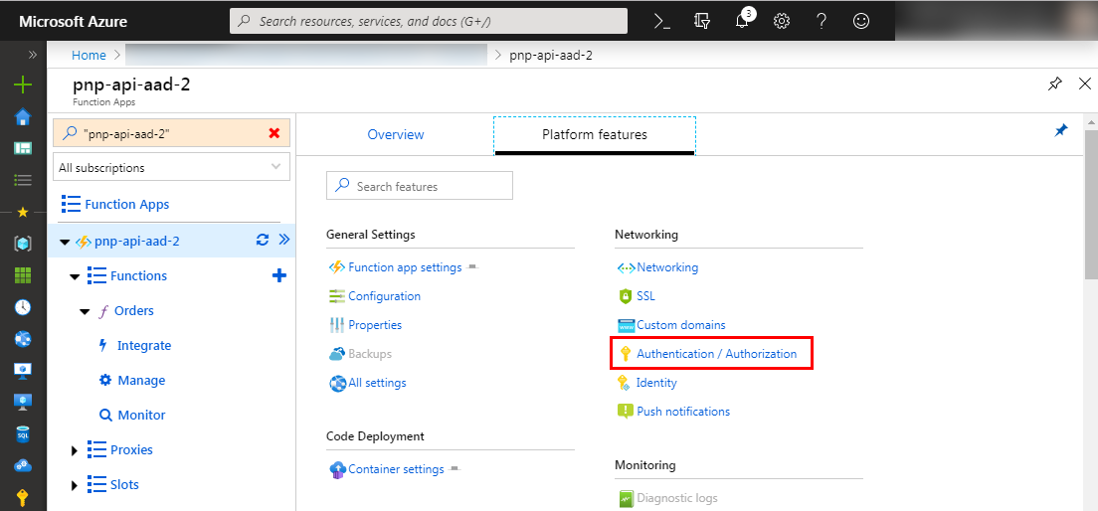
Securing Azure Functions

Slide 12
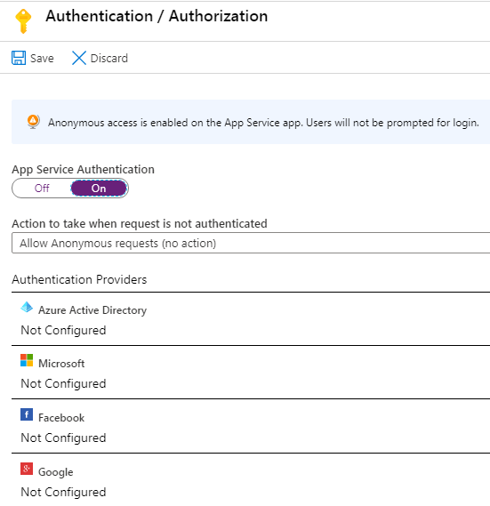
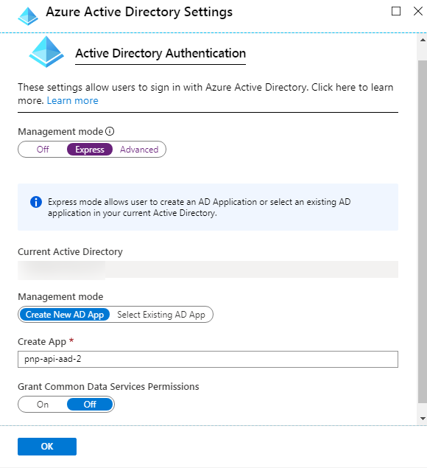
Securing Azure Functions

Slide 13
Calling Azure AD Secured Resources from SPFx
Permission requests to resources are granted to special SharePoint app by tenant admin
SharePoint Online Client Extensibility Web Application Principal
Present in each SharePoint Online tenant
Permissions are unique to the tenant, not the SPFx solution
Once a permission is granted, all solutions can leverage the grant
Permission grant is valid until revoked
Permission grant not directly linked to the solution that requested it
Solution installation not linked to permission grant approval / rejection

Slide 14
Granting Permissions to SharePoint Online
Special SharePoint Online Azure AD app can be granted permissions to resources in multiple ways:
Defined within solution manifest – admin notified upon deployment to approve/reject
PowerShell
Office 365 CLI
Ref: https://docs.microsoft.com/sharepoint/dev/spfx/use-aadhttpclient

Slide 15
SPFx Solutions Declare Permission Requests
// package-solution.json
{
"$schema": "https://developer.microsoft.com/json-schemas/spfx-build/package-solution.schema.json",
"solution": {
"name": "sp-fx-aad-http-client-side-solution",
"id": "dfb230b7-4f61-431f-9b65-a34e83922663",
"version": "1.0.0.0",
"includeClientSideAssets": true,
"isDomainIsolated": false,
"webApiPermissionRequests": [
{ "resource": "Microsoft Graph", "scope": "User.ReadBasic.All” }
]
},
"paths": {
"zippedPackage": "solution/sp-fx-aad-http.sppkg"
}
}

Slide 16
How It Works: Calling Azure AD Secured REST APIs from SPFx

Slide 17
Using the Azure AD HTTP Client
import { AadHttpClient, HttpClientResponse } from '@microsoft/sp-http';
this.context.aadHttpClientFactory
.getClient([name / URI of target resource])
.then((aadClient: AadHttpClient) => {
const endpoint: string = 'https://secured endpoint'
aadClient.get(endpoint, AadHttpClient.configurations.v1)
.then((rawResponse: HttpClientResponse) => {
return rawResponse.json();
})
.then((jsonResponse: any) => {
// work with result
});
});
});

Slide 18
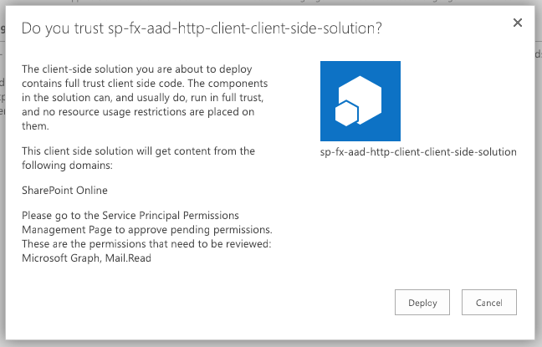
Add SharePoint Package to SharePoint App Catalog
Upload SharePoint packages to the app catalog
Extra note in dialog notifies of additional step required
While application can be installed in SharePoint sites, it does not have the permissions granted that it needs to access Azure AD protected resources

Slide 19
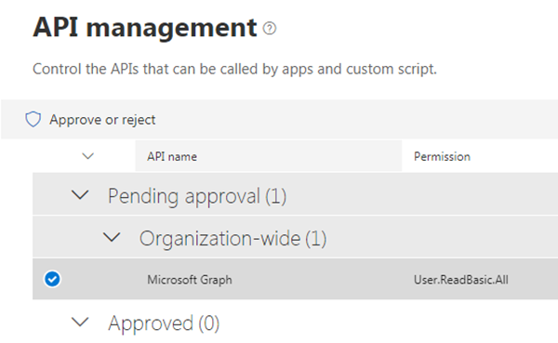
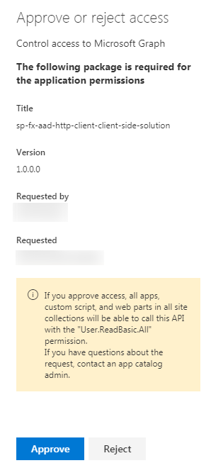
Approve / Reject with SharePoint Online API Management Page

Slide 20
Demo Calling the Microsoft Graph
Notes:
Demo steps:
https://github.com/SharePoint/sp-dev-training-spfx-graph-3rdpartyapis/tree/master/Demos/02-aadhttpclient

Slide 21
Summary
Azure AD Protected Resources & SPFx: How it Works
Permission Requests
SPFx’s AadHttpClient

Slide 22
Leverage the Microsoft Graph & 3rd Party APIs
Calling the Microsoft Graph

Slide 23
Calling the Microsoft Graph
Overview of the Microsoft Graph
Microsoft Graph JavaScript API
TypeScript Type Declarations
SPFx’s MSGraphClient

Slide 24
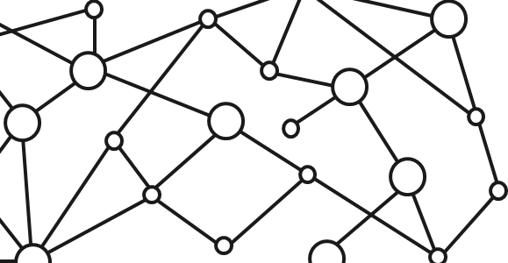
Microsoft 365 Platform
Extend Microsoft 365 experiences
web, device, and service apps
Build your experience
Documents
Pages
Conversations
Timeline
iOS/Android/Windows/Web
1
Microsoft Graph
Notes:
Our Office 365 developer vision focuses on the Users’ experience and their data. As a developer you can bring your applications into their user experience. With over 1.2+ billion users of Office Worldwide, this is a huge opportunity to provide a window into your applications. As well as being able to connect into their data and add intelligence to your applications. There are currently 850 million events created a month and a total of 470Pb+ of data stored in the service that can add value to for our Users’.

Slide 25
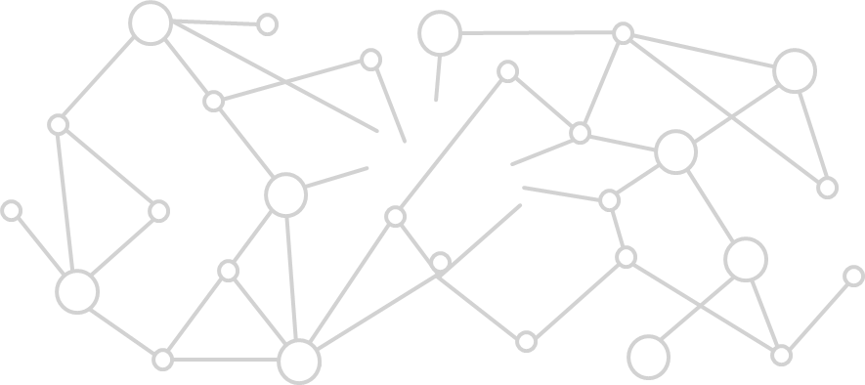
Microsoft Graph Gateway to your data in the Microsoft-cloud
https://graph.microsoft.com
Office 365
Windows 10
Enterprise Mobility + Security
Users, Groups, Organizations
Outlook
SharePoint
OneDrive
Teams
Planner
Excel
OneNote
Activities
Device Relay
Commands
Notifications
Azure AD
Intune
Identity Manager
Advanced Threat Analytics
Advanced Threat Protection
Mail, Calendar,
Contacts and Tasks
Sites and Lists
Drives and Files
Channels, Messages
Tasks and Plans
Spreadsheets
Notes, and more…
Identity Management
Access Control
Synchronization
Domains
Administrative Units
Applications and Devices
Advanced Threat Analytics
Advanced Threat Protection
Alerts
Policies
and more…

Slide 26
Microsoft Graph, gateway to Office 365
Single resource that proxies multiple Microsoft services
Allows for easy traversal of objects and relationships
Simplifies token acquisition and management
Eliminates the need to traditional discovery (using “me” and “myorganization”)

Slide 27
Microsoft Graph JavaScript SDK
Microsoft Graph is accessible via REST API & various SDKs
Client-side solutions can leverage the JavaScript SDK
https://github.com/microsoftgraph/msgraph-sdk-javascript
Requires initialization with an Azure AD provided OAuth2 access token to create the client
Notes:
Let’s review from the previous section

Slide 28
Initializing the Microsoft Graph JS SDK
var client = MicrosoftGraph.Client.init({
authProvider: (done) => {
done(null, access_token);
}
});
client
.api('/me')
.get((err, res) => {
console.log(res);
});

Slide 29
Microsoft Graph TypeScript Type Declarations
Use the Microsoft Graph JavaScript SDK in TypeScript applications
TypeScript type declarations introduce strong types and documentation to client-side projects
https://github.com/microsoftgraph/msgraph-typescript-typings

Slide 30
Microsoft Graph TypeScript Type Declarations
import * as MicrosoftGraph from '@microsoft/microsoft-graph-types';
// init Microsoft Graph client
client
.api('/me')
.get((error: any, user: MicrosoftGraph.User, rawResponse?: any) => {
console.log('name: ', user.displayName);
console.log('email: ', user.mail);
console.log('phone: ', user.businessPhones[0]);
});
});

Slide 31
SharePoint Framework Includes a Microsoft Graph Client
MSGraphClient: SharePoint Framework’s Microsoft Graph Client
Abstracts the token acquisition from the SharePoint Framework’s support for Azure AD
Wraps the Microsoft Graph JavaScript SDK and initializes it with one line that returns a promise
this.context.msGraphClientFactory
.getClient()
.then((client: MSGraphClient): void => {
// use MSGraphClient here
});

Slide 32
SPFx Solutions Declare Permission Requests
// package-solution.json
{
"$schema": "https://developer.microsoft.com/json-schemas/spfx-build/package-solution.schema.json",
"solution": {
"name": "ms-graph-sp-fx-client-side-solution",
"id": "dfb230b7-4f61-431f-9b65-a34e83922663",
"version": "1.0.0.0",
"includeClientSideAssets": true,
"isDomainIsolated": false,
"webApiPermissionRequests": [
{ "resource": "Microsoft Graph", "scope": "User.ReadBasic.All” },
{ "resource": "Microsoft Graph", "scope": "Calendars.Read” },
{ "resource": "Microsoft Graph", "scope": "Tasks.Read” }
]
},
"paths": {
"zippedPackage": "solution/ms-graph-sp-fx.sppkg"
}
}

Slide 33
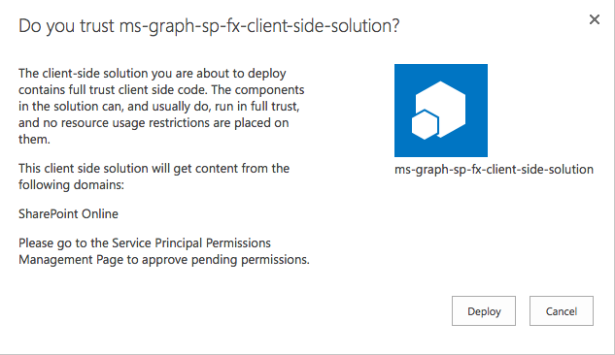
Add SharePoint Package to SharePoint App Catalog
Upload SharePoint packages to the app catalog
Extra note in dialog notifies of additional step required
While application can be installed in SharePoint sites, it does not have the permissions granted that it needs to access Azure AD protected resources

Slide 34
Approve / Reject with SharePoint Online API Management Page

Slide 35
Demo Calling the Microsoft Graph
Notes:
Demo steps;
https://github.com/SharePoint/sp-dev-training-spfx-graph-3rdpartyapis/blob/master/Demos/03-msgraphclient/README.md

Slide 36
Summary
Overview of the Microsoft Graph
Microsoft Graph JavaScript API
TypeScript Type Declarations
SPFx’s MSGraphClient

Slide 37
Reading further
Overview of the SharePoint Framework
https://docs.microsoft.com/sharepoint/dev/spfx/sharepoint-framework-overview
Connect to Anonymous APIs
https://docs.microsoft.com/sharepoint/dev/spfx/connect-to-anonymous-apis

Slide 38
Reading further
Connect to API Secured with Azure Active Directory
https://docs.microsoft.com/sharepoint/dev/spfx/web-parts/guidance/connect-to-api-secured-with-aad
Connect to Azure AD-secured APIs in SharePoint Framework Solutions
https://docs.microsoft.com/sharepoint/dev/spfx/use-aadhttpclient
Use the MSGraphClient to Connect to Microsoft Graph
https://docs.microsoft.com/sharepoint/dev/spfx/use-msgraph

Slide 39
Lab In this lab you work with the SharePoint Framework to communicate with the Microsoft Graph and third party REST APIs in your SharePoint Framework project. aka.ms/spdevwsM4L6
Notes:
Lab manual at:
https://aka.ms/spdevwsm4l6

